Slide 1



‘Ask the Expert’
'Revolting Peasants'? Labour's changing membership: who they are and what they want
Speaker:
Professor Tim Bale, Queen Mary University of London
Chair:
Nida Broughton, Social Market Foundation
Wi-Fi
Network: SMF
Password: SMF_1989
#AskTheExpert

Slide 2
'Revolting Peasants'? Labour's changing membership: who they are and what they want
Tim Bale (QMUL), Paul Webb (Sussex) & Monica Poletti (QMUL)
Social Market Foundation, 6 September 2016

Slide 3
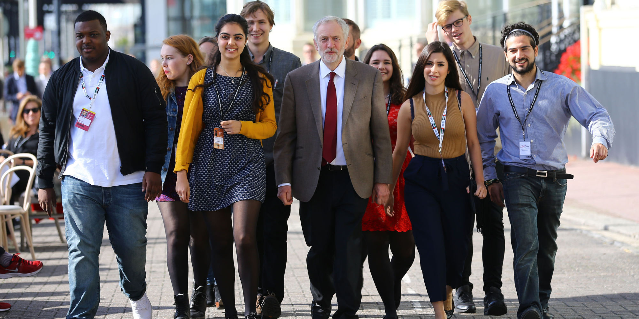

Slide 4
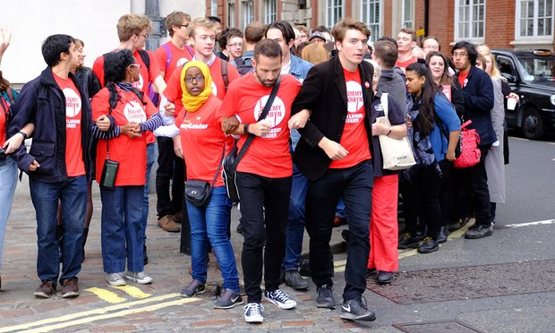

Slide 5
The Data: Party Members Project (PMP) http://esrcpartymembersproject.org
Funded by ESRC, 2015-2018
Involves surveys in 2015 of:
  Members of 6 parties
  Non-member partisans (strong party supporters)
  Labour’s affiliated trade unionists
Survey of Labour’s new joiners in 2016
Survey of party leavers in 2017
Interviews with party officials and elites on what they want/expect of members and how they deal with them.

Slide 6
Samples
Full members as of #GE2015: 201,293 (c.52% of total December 2015).
  Sample size 1180 (Fieldwork May 2015).
Post #GE2015 members: 187,114 (c.48% of total December 2015).
  Sample size 1117 (Fieldwork May 2016).

Slide 7
Demographic Similarities & Differences
Mean Age: Old = 51; New = 51
ABC1: Old = 76%; New = 75%
Graduates: Old = 56%; New = 58%
London: Old = 16%; New = 15%
South of England outside London: Old = 30%; New = 34%
Male/Female: Old = 62:38; New = 48:52

Slide 8
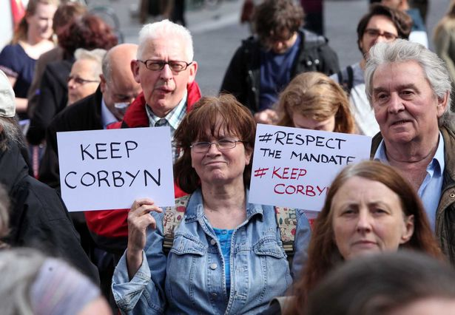

Slide 9
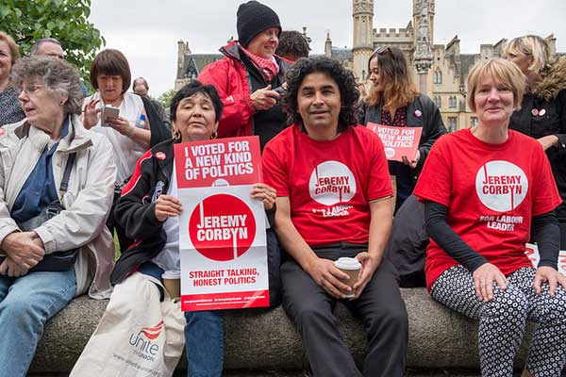

Slide 10
Similarly left-wing on state-market
Pro Redistribution: Old = 91%; New = 94%; Voters = 53%
Ord people don’t get fair share: Old = 94%; New = 96%; Voters = 72%
Management tries to get better of employees: Old = 92%; New = 96%; Voters = 69%
Spending cuts gone too far: Old = 92%; New = 99%

Slide 11
But considerably more socially liberal
Immigration bad (1)/good (7) for the economy: Old = 5.68; New = 5.79
Censorship of films and magazines: Old = 21%; New = 16%; Voters = 53%
Stiffer sentences: Old = 27%; New = 16%; Voters = 75%
Teach children to obey authority: Old = 40%; New = 23%; Voters = 77%

Slide 12
More likely to have flirted with the Greens
Voted Labour in #GE2015: Old = 90%; New = 70%
Voted Green in #GE2015: Old = 1%; New = 16%
Previously a member of the Greens: Old = ?*%; New = 7%
Previously a member of the Labour Party: Old = 28%; New = 32%

Slide 13
Less Active (Real-world) Campaigners?
Social media: Old = 51%; New = 70%
Leaflets: Old = 43%; New = 28%
Canvassing: Old = 36%; New = 15%
Never attended a party meeting: Old = 25%; New = 61%

Slide 14
Willing to consider de/re-selection
Labour MPs who continually vote against the party’s agreed line in Commons votes should be deselected’: Agree = 32% (Neither = 29%)
Labour MPs who persistently and publicly criticise the leadership in the media should be deselected: New = 55% (incl. 68% post-Corbyn joiners)
Mandatory re-selection: Pro = 59%; Anti = 25%

Slide 15
Value leader qualities differently
Being in touch with ordinary people: Old = 49%; New = 67%
Good communicator: Old = 50%; New = 35%
Having strong political beliefs: Old = 32%; New = 49%
Strength and authority: Old = 26%; New = 18%
Appealing to the average voter: Old = 39%; New = 25%
Ability to unite the nation: Old = 34%; New = 26%
Ability to unite the party: Old = 27%; New = 13%

Slide 16
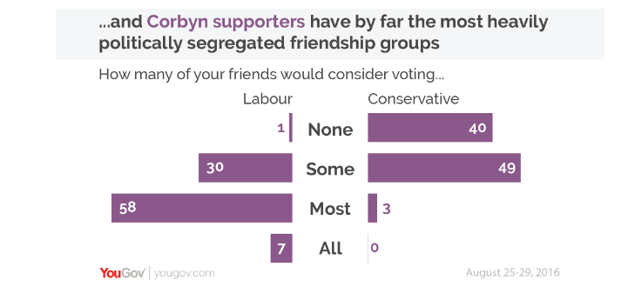
‘Other products are available….’
(@mattsmithetc & @election_data)

Slide 17
Follow us via….
Web: http://esrcpartymembersproject.org
Twitter: @ESRCPtyMembers
Facebook: ESRC Party Members Project
Email: partymembersproject@gmail.com

Slide 18


